Slide 1
Implementation of IoT Communication Models and Protocols
Vraj Suratwala
Department of ICT, VNSGU

Slide 2
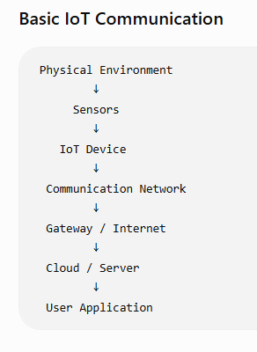
Introduction
IoT communication refers to the exchange of data between sensors, devices, gateways, servers, cloud platforms, and users through communication networks.
In an IoT system, devices continuously collect data from the physical environment and communicate this data to other devices or applications. Different communication models and protocols are used depending on the application, distance, power requirements, data size,
and network conditions.

Slide 3
IoT Communication Models
There are four important IoT communication models:
  Request–Response Model
  Publish–Subscribe Model
  Push–Pull Model
  Exclusive Pair Model

Slide 4
2.1 Request–Response Model
In this model, a client sends a request to a server, and the server sends back a response.
Client / IoT Device
│
Request
↓
Server
│
Response
↓
Client / IoT Device
Example
A mobile application requests the current temperature:
Mobile App → Request → IoT Server
Mobile App ← Response ← IoT Server
Common Protocol
HTTP/HTTPS is commonly used for request–response communication.
Applications
Web APIs
IoT dashboards
Retrieving sensor information
Device configuration

Slide 5
2.2 Publish–Subscribe Model
In the Publish–Subscribe (Pub-Sub) model, devices do not communicate directly with each other.
A central broker manages the communication.
Publisher → Sends messages
Broker → Receives and distributes messages
Subscriber → Receives messages

Slide 6
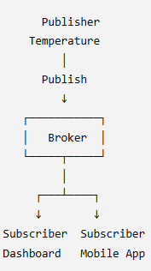
Publish–Subscribe Model
Example
A temperature sensor publishes:
Topic: home/temperature
Value: 29°C
Any subscriber to home/temperature receives the value.
Common Protocol
MQTT is the most important example.
Applications
Smart homes
Industrial IoT
Sensor monitoring
Real-time notifications

Slide 7
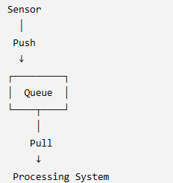
2.3 Push–Pull Model
In the Push–Pull model, one component pushes data into a queue, while another component pulls data from the queue for processing.
Example
Multiple IoT sensors can continuously push readings into a queue. A processing system pulls those readings and processes them.
Applications
  Data collection
  Distributed processing
  Large-scale sensor systems
  Data pipelines

Slide 8
2.4 Exclusive Pair Model
In the Exclusive Pair model, two devices establish a persistent, two-way connection and communicate directly.
┌────────────┐ Two-way ┌────────────┐
│ IoT Device │◄──────────►│ Server │
└────────────┘ Connection └────────────┘
Both devices can send and receive data.
Common Example
WebSocket can provide continuous two-way communication between a client and server.
Applications
Real-time monitoring
Live control systems
Device-to-device commun

Slide 9
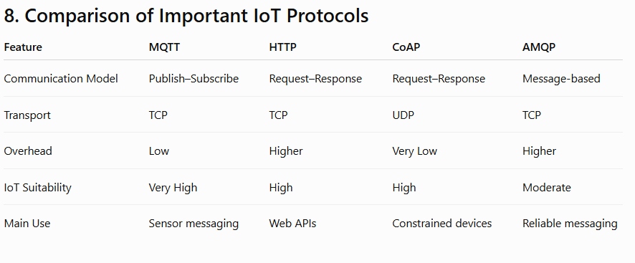

Slide 10
Thank You
Vraj Suratwala
Department of ICT, VNSGU

